Slide 1

moose for dcs world AIR 2 GROUND dispatcher

Slide 2
Air 2 ground dispatcher player experience

Slide 3
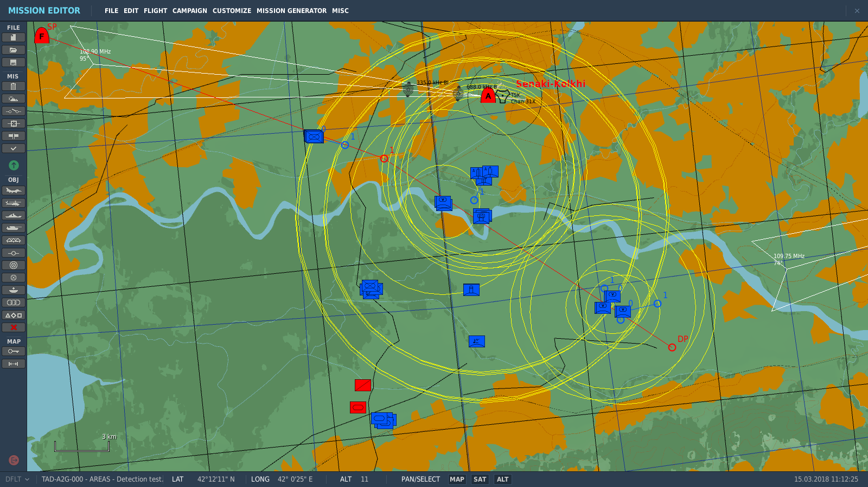
player experience: situation
Blue enemy Target Area

Slide 4
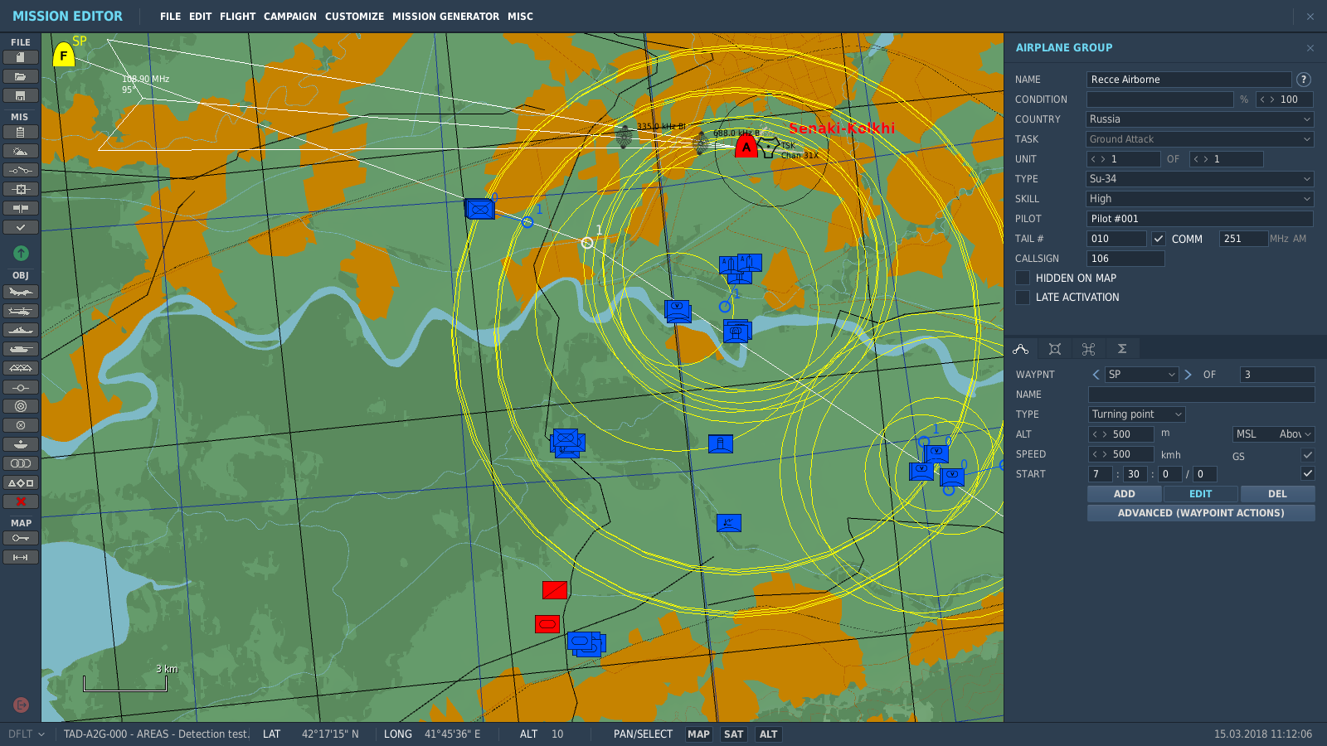
player experience: situation
Recce Groups which are Detecting (RecceSet)

Slide 5
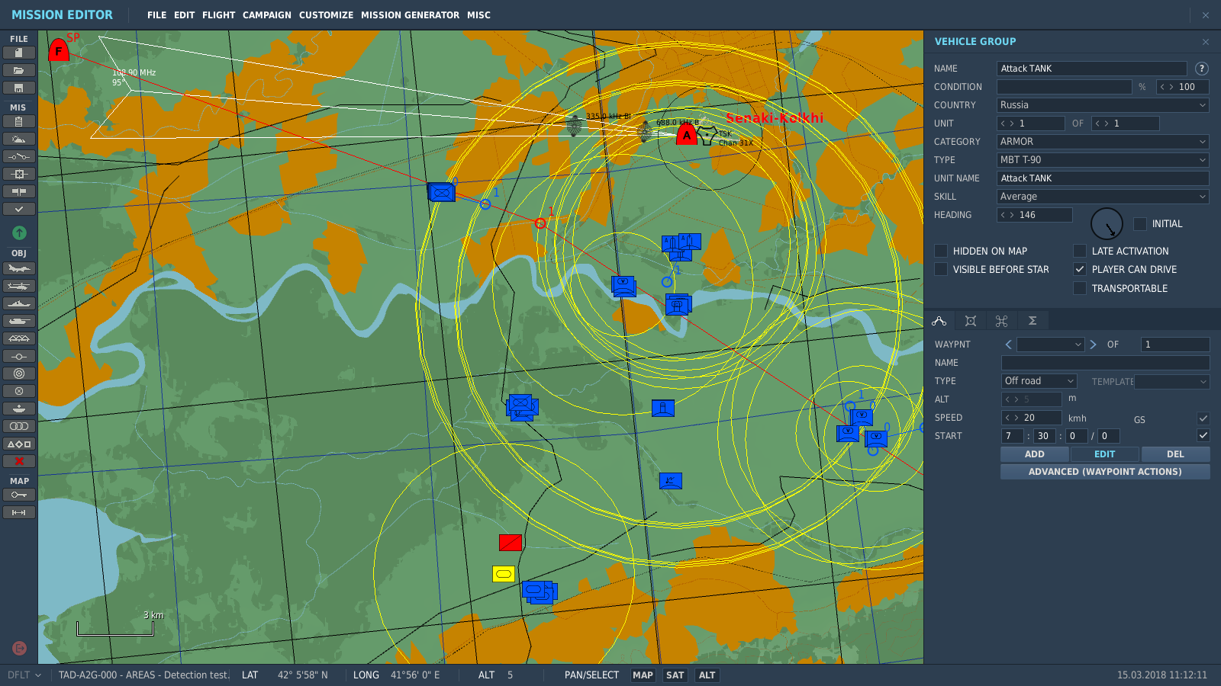
player experience: situation
Attack Units for Players (AttackSet)

Slide 6
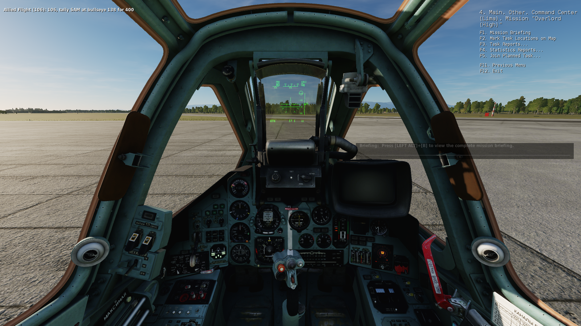
player experience: Mission menu

Slide 7
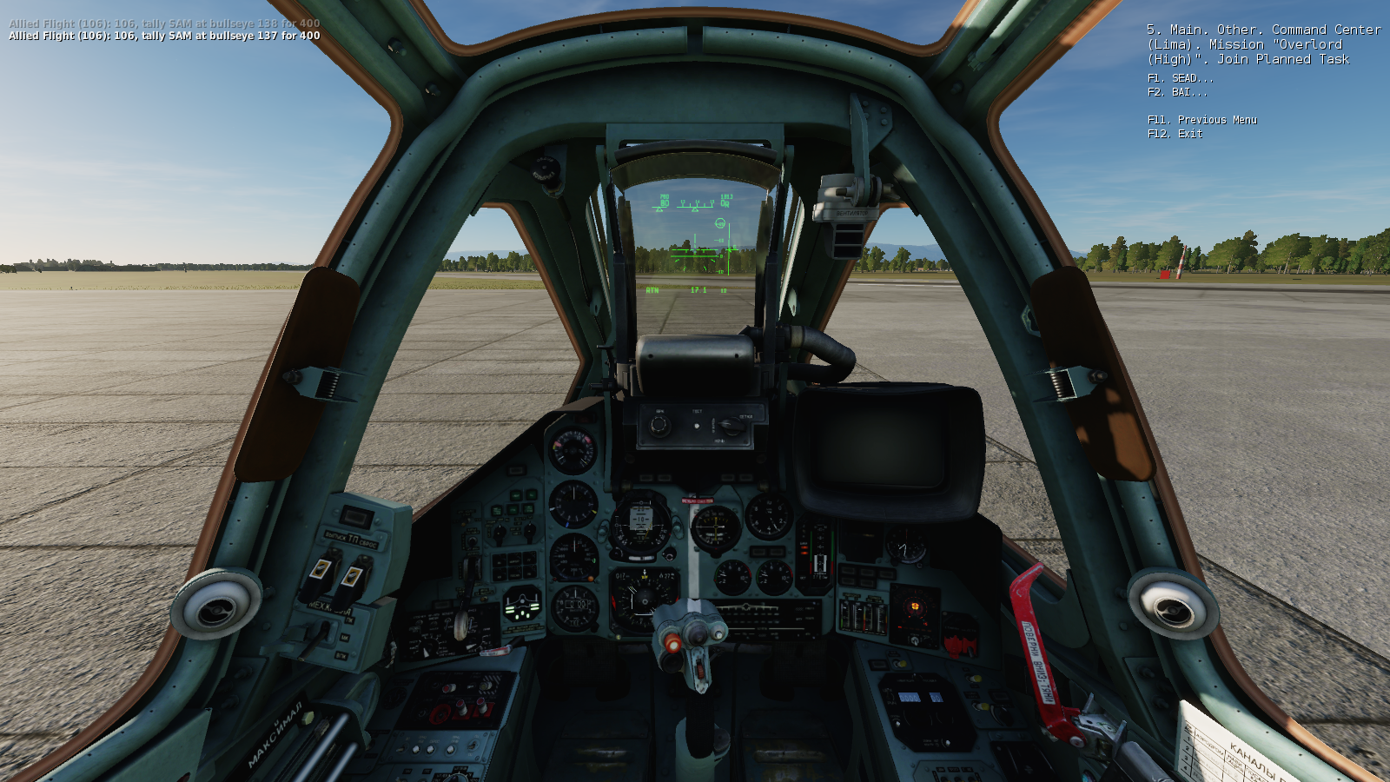
player experience: join task

Slide 8

join task

Slide 9

planned task menu

Slide 10
tactical situations

Slide 11
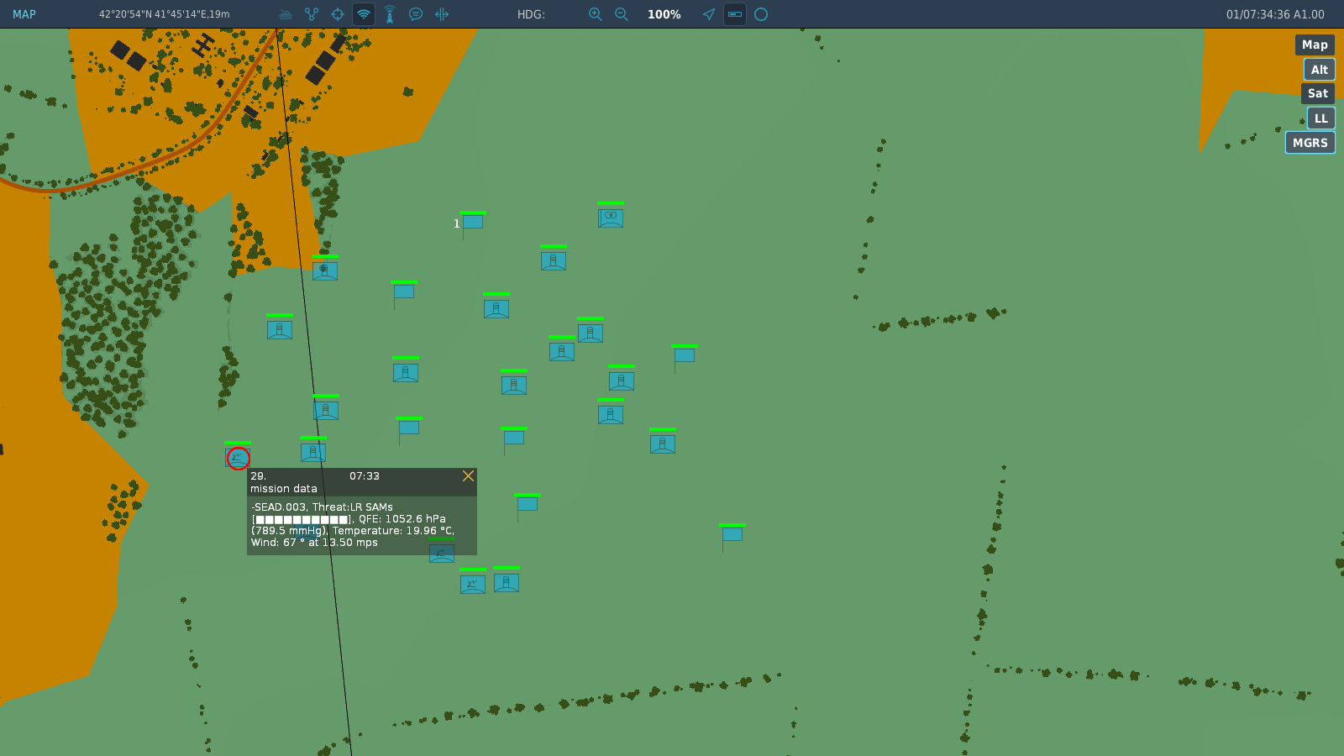
tactical situation: sead task
SEAD Task
Once all Radar Emitting Units have been destroyed, the Task will convert into a BAI or CAS task!
A CAS and BAI task may be converted into a SEAD task, once a radar has been detected within the area!
Radar Emitters

Slide 12
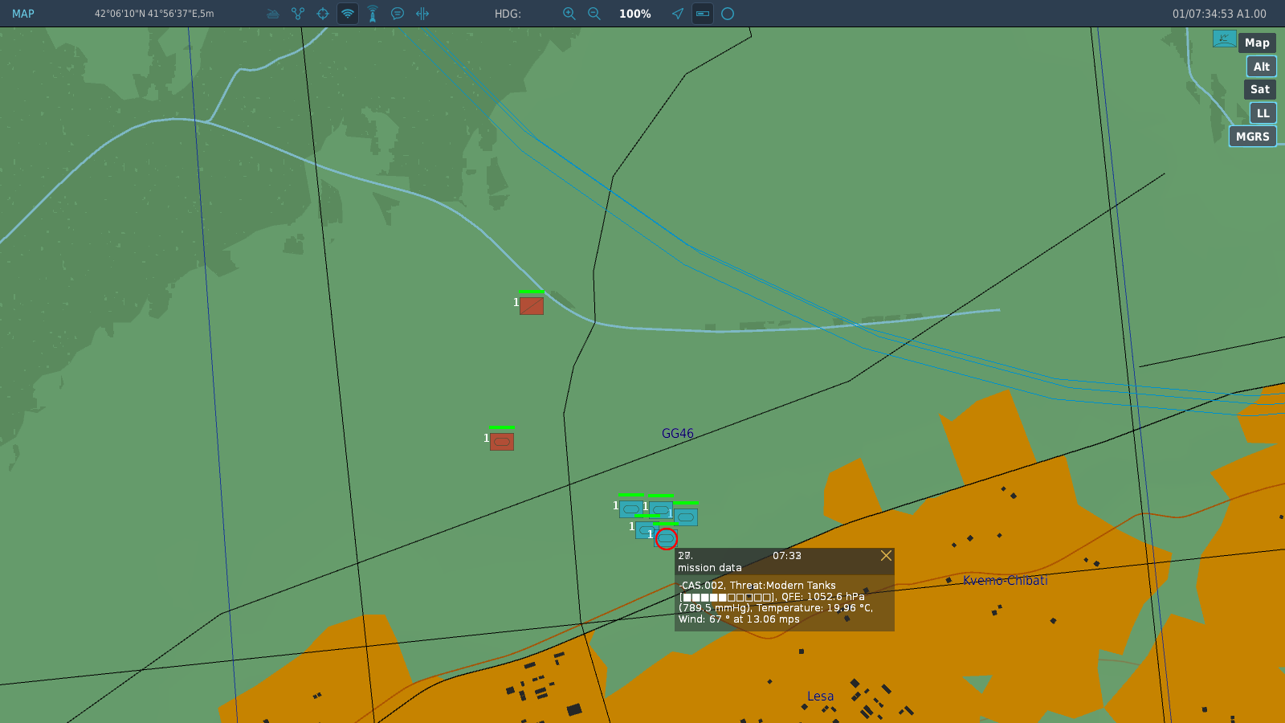
tactical situation: CAS task
CAS Task
After the detection of the CAS task, if the friendly Units are destroyed, the CAS task will convert into a BAI task!
Friendly within 6km from enemy
Friendly must be a ground Unit!

Slide 13
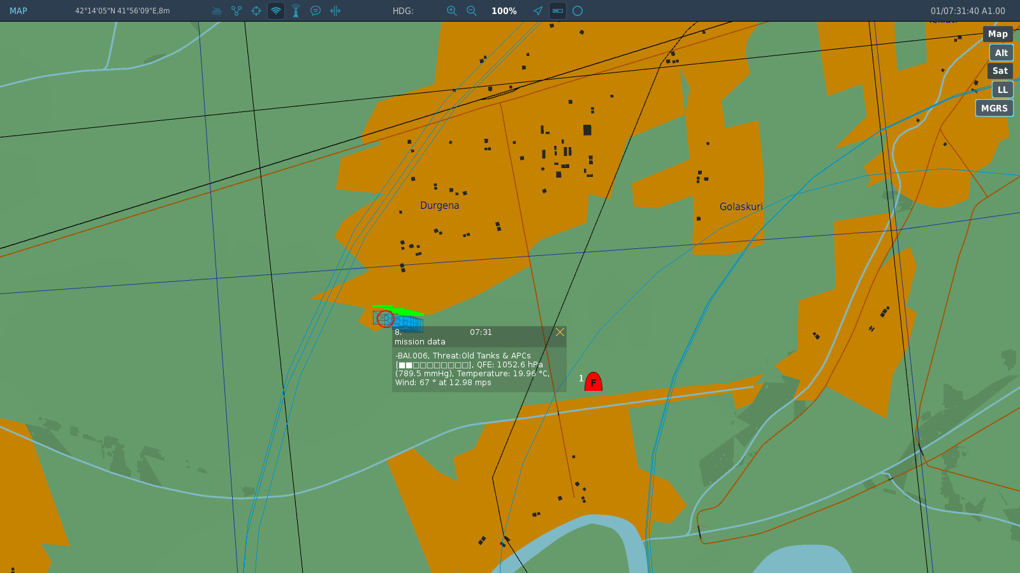
tactical situation: BAI Task
An Air Unit is not a Ground Unit! So BAI!
BAI Task
A BAI task may be converted into a CAS task if friendly Ground Units approach within 6 km range!

